Slide 1
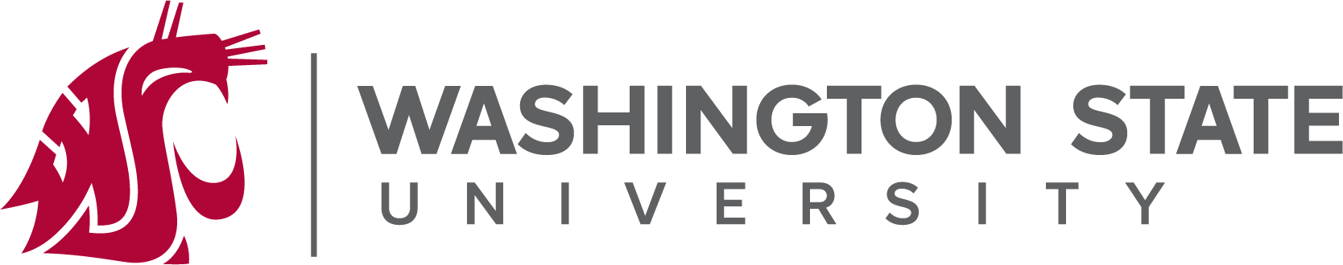

Disloyal Managers and Shareholders’ Wealth
Finch, Hartford, and Tran
RFS | Forthcoming

Slide 2
Do Disloyal Managers Harm Shareholders’ Wealth?
WSU
Research Question
“The prohibition against fiduciaries appropriating business opportunities from their companies is a fundamental part of the duty of loyalty, the expectation of which is integral to U.S. corporate governance.”
Decreased public firms’ investment in innovation
Decreased investment in R&D, a decrease in valuable patents
Innovation activities contribute less to firm value (Market Reaction & Tobin’s Q)
However, this contracting flexibility positively impacts small and emerging firms

Slide 3
COWs
WSU
Premise
“The duty of loyalty has long been characterized as inveterate and unyielding: While much of corporate law consists of ‘default rules’ that parties may freely alter, loyalty is widely perceived as ‘immutable’-impervious to private efforts to dilute, tailor, or eliminate it.”
- Opting Out of the Fiduciary Duty of Loyalty (harvard.edu)
This perception is, unfortunately, false:
Beginning in 2000, Delaware dramatically departed from longstanding tradition, amending its statues to enable corporations to waive a critical component of loyalty-the corporate opportunity doctrine-which forbids corporate fiduciaries from appropriating new business prospects for themselves without first offering them to the company.
Delaware corporations and managers were free to contract out of a significant portion of the duty of loyalty (>50% US incorporated in Delaware)

Slide 4
WSU
Premise
Corporate Opportunity Waiver
“The duty of loyalty has long been characterized as inveterate and unyielding: While much of corporate law consists of ‘default rules’ that parties may freely alter, loyalty is widely perceived as ‘immutable’-impervious to private efforts to dilute, tailor, or eliminate it.”
- Opting Out of the Fiduciary Duty of Loyalty (harvard.edu)
This perception is, unfortunately, false:
Beginning in 2000, Delaware dramatically departed from longstanding tradition, amending its statues to enable corporations to waive a critical component of loyalty-the corporate opportunity doctrine-which forbids corporate fiduciaries from appropriating new business prospects for themselves without first offering them to the company.
Delaware corporations and managers were free to contract out of a significant portion of the duty of loyalty (>50% US incorporated in Delaware)

Slide 5
Intention-to-Treat
WSU
Methodology
While the adoption of COWs by state legislatures is exogenous, the decision to implement a waiver is endogenous to the firm.
“Unlike the TOT effects, our ITT effects provide unbiased estimates of the average impact of a treatment on the cohort of firms eligible to embrace the waiver.”
The Lower Bound
“To the extent that firms which are incorporated in states that enact the law do not include the waiver in their respective charters, our analyses would underestimate the true effect of the waiver law.”
Consequently, ITT effects the authors report should be viewed as a ‘lower bound’ to the treatment-on-the-treated (TOT) effects.

Slide 6
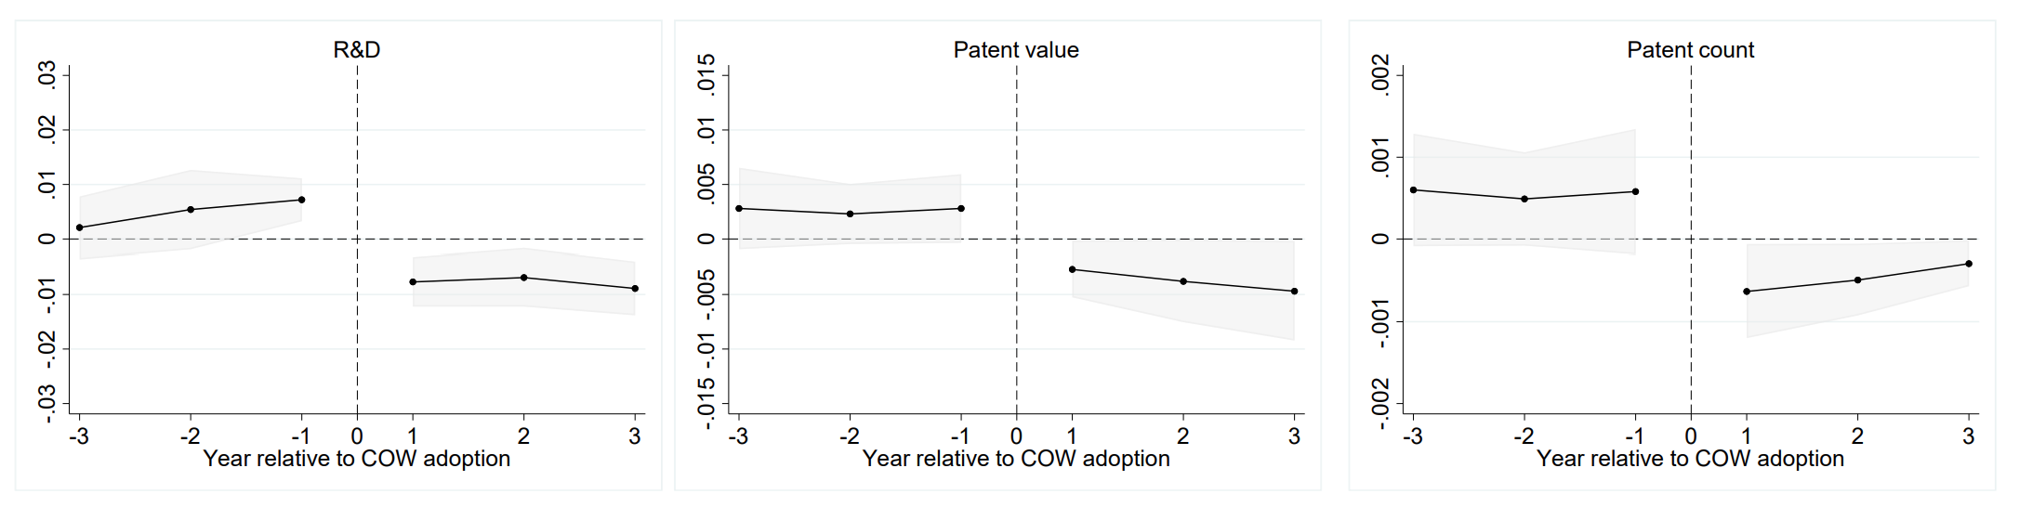
COWs and Innovation
WSU
Results
While at small firms, agency conflicts are not as severe and the flexibility for financing and advising will outweigh the agency conflict, the same is not true for large firms. As such, mangers covered by a corporate opportunity waiver could legally pursue and develop new business project for their personal benefit without obligations of offering them to their firms.
Firm capture of innovation output (patents) is predicted to decrease, but the prediction of innovation (R&D) is ambiguous.
After COW Adoptions
R&D spending drops by 19% (from the sample mean)
Innovation ‘value’ falls by 18% (from the sample mean)
Patent counts decline by 9% (from the sample mean)

Slide 7
COWs and Innovation
WSU
Results
“Overall, [Figure 1 and Table 3] suggest that once corporate fiduciaries can lawfully appropriate new business opportunities for themselves… the relative contribution of innovation to their firm's market value declines sharply.”

Slide 8
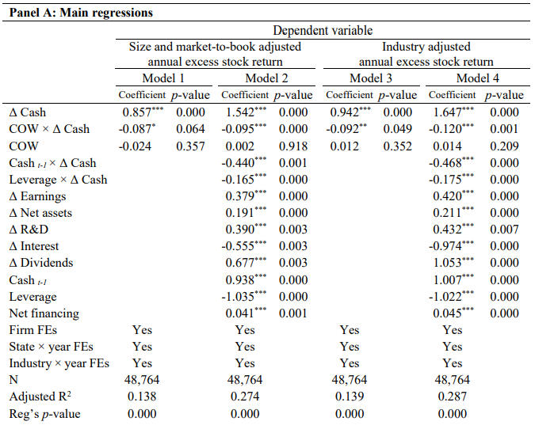
COWs and Cash
WSU
Results
Dittmar and Mahrt-Smith (2007) show that the value of an extra dollar of cash is lower in firms with poor corporate governance.
According to Table 5, the value of an additional dollar falls by 9 to 12 cents in firms incorporated in states that pass COWs.
This decrease is economically large, ~one standard deviation of the marginal value of cash (10.4 cents)

Slide 9
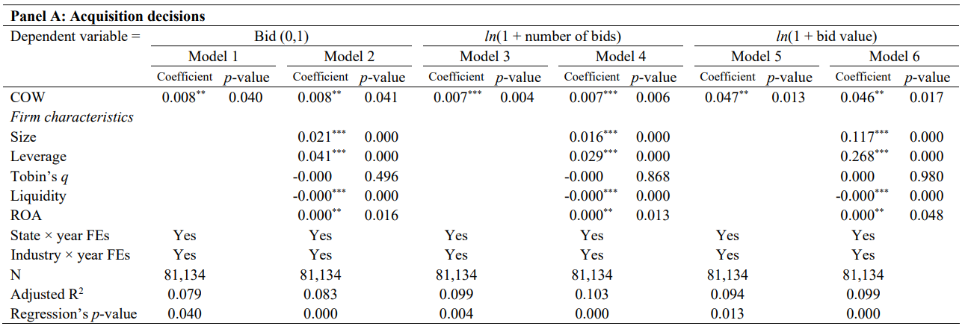
COWs and Acquisitions
WSU
Results
Are firms covered by COW laws?
More likely to make acquisition bids
More likely to make bids that are met w/negative market reaction(s)
Less likely to withdraw from M&A deals that trigger negative returns
The COW Indicator:
COW states are 0.8% more likely to make a merger bid (~14%)
COW states increase M&A bids 0.7% (5.7%)
COW states increase 4.7% in total M&A deal value

Slide 10
COWs and Acquisitions
WSU
Results

Slide 11
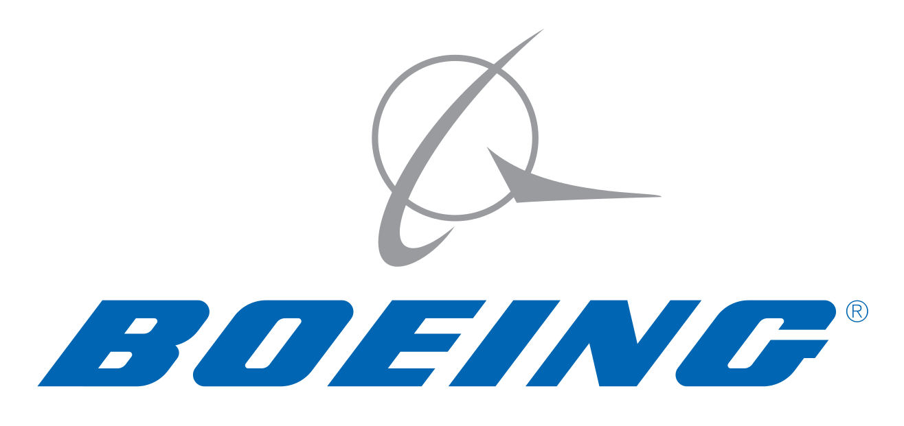

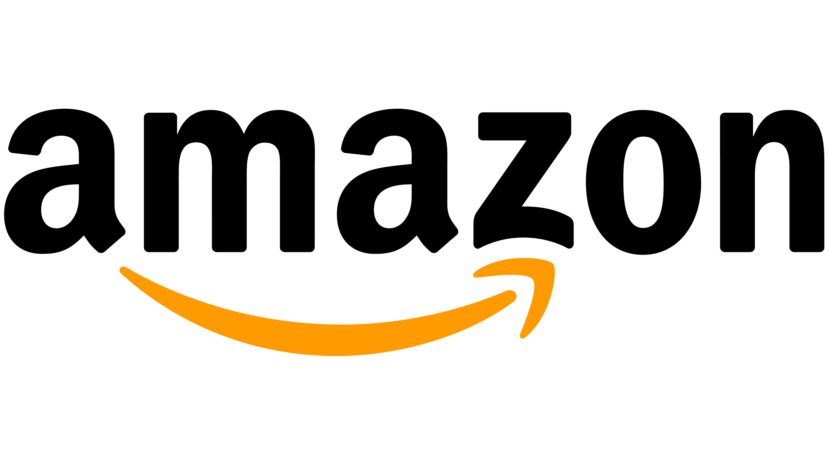
Reincorporation Critique
WSU
Critique
Most U.S. companies are incorporated in Delaware (>50%, 66.8% S&P 500, and ~93% of all IPOs).
The Delaware Effect
HQ Differences
Migration of Incorporation
A Local Example:

Slide 12



Conclusions
WSU
“In 2000, a quiet revolution in the standards of corporate governance started.”
Small, emerging firms, where agency conflicts are less of a concern, may benefit
Larger firms might exploit these COWs
Following COW statutes, contribution to innovation decreases
Authors uncover evidence that investor reactions upon the enactment of COWs are positive for small cap stocks
Parallel Trends and Serial Correlation are still a concern.

Slide 13
How does Shareholder Governance Affect the Cost of Borrowing? Evidence from the Passage of Anti-Takeover Provisions
Liu & Wu
JAE | 2022

Slide 14
What is the Effectiveness of Shareholder Governance (ATPs)?
WSU
Research Question
Prior studies document positive stock market reactions to the passage of governance proposals, especially anti-takeover provisions (Cunat et al.,2012).
In theory, the passage of governance proposals could have either beneficial or detrimental effects on firms’ creditors.
Entrenchment Reduction Channel
If passing reduces management entrenchment, it could decrease monitoring costs for creditors (lead to lower interest rates and relaxed contracts)
Agency Conflicts Channel
If passing exacerbates agency conflicts between shareholder and creditors, creditors would react negatively, and lenders would demand higher interest rates

Slide 15
Passage ≠ Implementation
WSU
Methodology
Firms’ decisions to adopt governance provisions are endogenous, and it is difficult to distinguish the impact of shareholder governance from other factors that affect firms’ cost of borrowing, such as unobservable firm credit risks.
An RDD Approach:
“The validity of the regression discontinuity research design requires a discrete jump in the implementation probability of voted proposals at the passing threshold… shareholder proposal are non-binding.”
5.9%
59.2%
8.2%
41.5%
Pass Rate (0-100%)

Slide 16
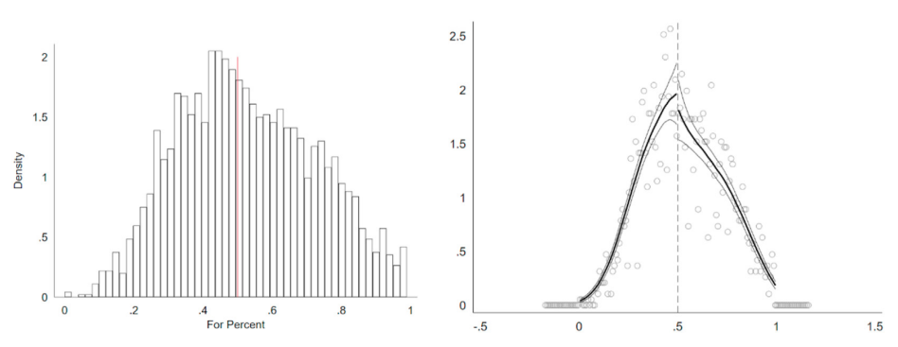
SEC Rule 14a-8
WSU
Hypothesis Development
Under Rule 14a-8 of the Securities and Exchange Act of 1934, any eligible shareholder can include a non-binding shareholder proposal in the company’s proxy statement for a vote at the next annual meeting.
Following Cunat et al. (2012), authors focus on proposals that remove G-index or anti-takeover-related provisions (since removing these provisions strengthens shareholder governance.
Panel A (Fig 1) – plots the distribution of the vote share in favor of shareholder sponsored governance-related proposals (smooth frequencies around mean)
Panel B (Fig 1) – shows the continuity smoothness test (McCrary, 2008), that is insignificant around the mean (cannot reject the null hypothesis that the discontinuity is zero)

Slide 17
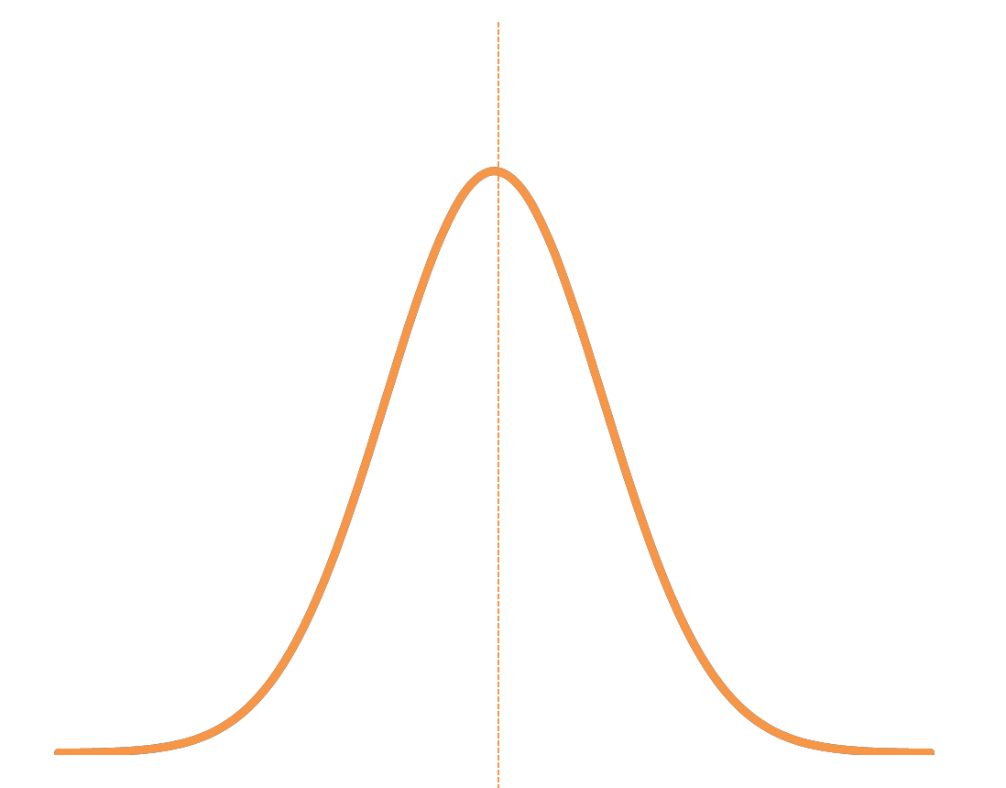
SEC Rule 14a-8
WSU
Hypothesis Development

Slide 18
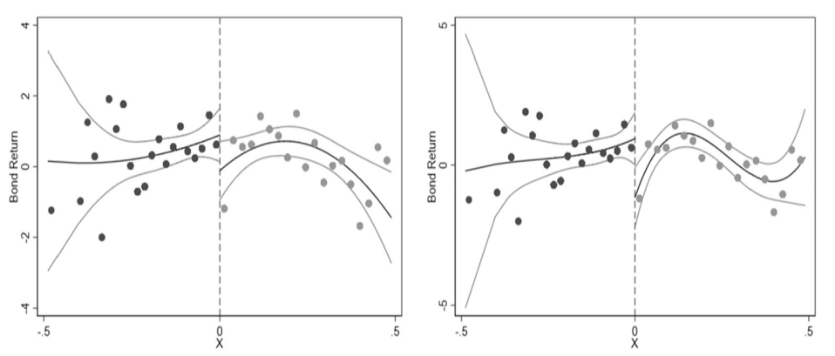
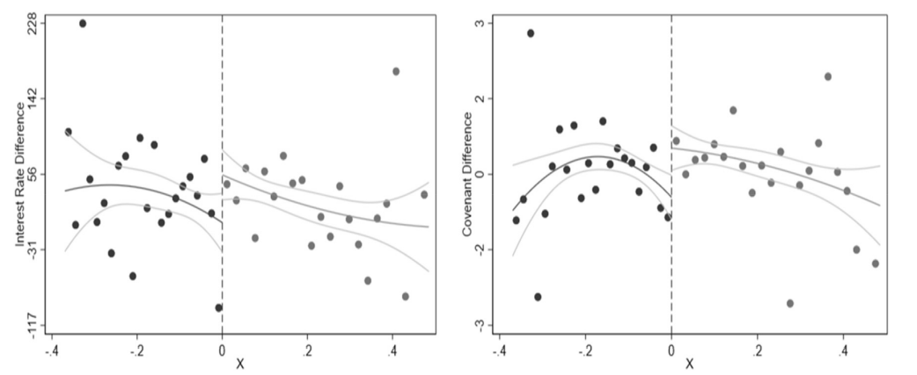
Public Debt & Loan Issuance
WSU
Results
Figure 2
Investigating the reactions of public debt market to passage of proposals using corporate bond returns
Panels A and B (2nd and 3rd degree polynomials) illustrates the discontinuity in the public debt market
Figure 3
Tests the passage of proposals affect on loan interest rates
Panel A shows the discontinuity in interest rates
Panel B shows the changes in the number of general covenants around the threshold

Slide 19
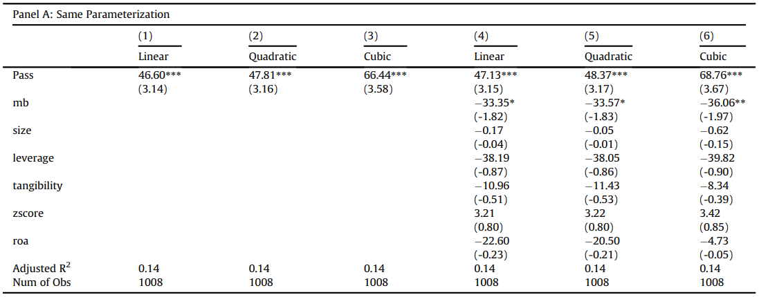
Loan Interest Rates
WSU
Results
“Table 4 presents the empirical results for our main regression specification.”
The point estimates of ‘Pass’ suggest that the passage of governance proposals leads to an increase in loan interest rates
For examples, the quadratic model shows that passing a proposal leads to a 47.8 basis point increase in the loan spread
These results suggest that passing governance proposals leads to an increase in borrowing costs from banks

Slide 20
Loan Interest Rates
WSU
Results

Slide 21
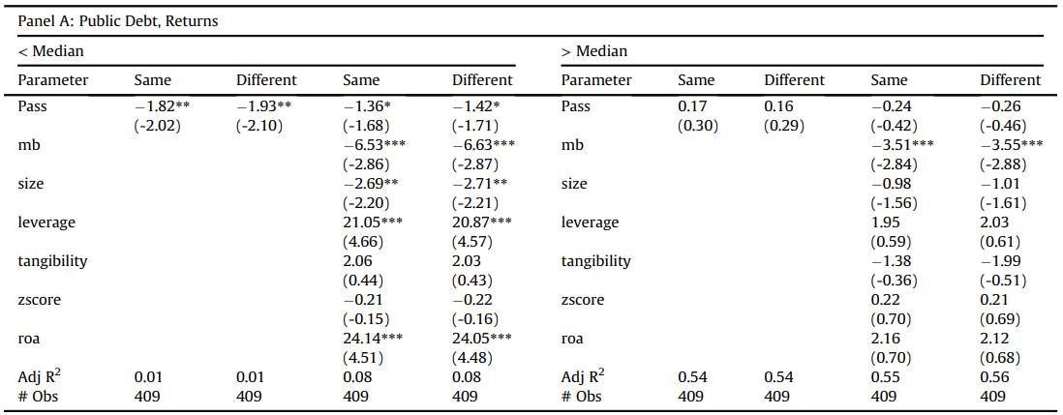
Risky Firms
WSU
Results
“The evidence thus far corresponds with the Agency Conflict Channel, where stronger shareholder control and high alignment of interests between shareholders and managers may intensify conflicts of interest between shareholders and creditors.”
A direct implication: the adverse effects of improved internal governance on creditors should be more pronounced for ex ante risker firms.
Splitting the firms by Z-score prior to their shareholder meetings,
Authors find that firms’ cost of borrowing is more pronounced for the lower Z-score subsample
The point estimates of the low Z-score firms are much larger than those for high Z-score firms
However, Z-score is inherently an endogenous variable.

Slide 22
Risky Firms
WSU
Results

Slide 23
Conclusions
WSU
“Examining public debts and private loans, we find consistent evidence that passing governance proposals significantly increases firms’ cost of borrowing.”
Significant and negative reactions to the passage of proposals in the public debt market
Banks demand higher interest rates and more general covenant in loan contracts after passage
These results are in line with the Agency Conflicts channel: creditors appear concerned about increased shareholder-debtholder conflicts after internal corporate governance improvement
These effects on creditors are stronger among riskier firms (firms with passed proposals become more volatile, too)

